Slide 1
Implementing 802.11ah
Migration analysis from a 802.11/a/g/p transceiver in GNUradio
D. Zwart Technical University of Delft
Delivered: 16-05-2018

Slide 2
Pre-word
Documentation associated with this presentation can be found in wiki. Please refer to this github wiki for updated references to:
Reports
Papers
Matlab sources
GNUradio sources
Slides show a (->) link in the title, which links to the wiki.

Slide 3
Contents
Previous developments
Achievements D. Verhaert
Limitations (changes to make model work)
Current work
Goals w.r.t reality
Achievements
Documentation
Future implementation

Slide 4
Previous developments (1/2) (->)
GNUradio transceiver with
USRP N210 SDR with 2x VERT900 antenna’s
Ubuntu 16.04 LTS
Pybombs & GNUradio (long prefix build time)
Installation guide by D. Verhaert avoids GNUradio, Apache & USRP driver trouble

Slide 5
D. Verhaert achievements (->)
GNUradio transceiver with slight adaptations:
Based on 2.4GHz 802.11a/g/p
Added USA frequency option (902 – 928 MHz)
Set channel BW to 2 MHz
Added file sink as capture (FileSinkah)
Attempted higher MCS indices, removed because of packet loss.
Successfully transmitted small WiFi payloads (no ETH layer, pure PHY+MAC)
Reproducible results

Slide 6
Previous developments (2/2) (->)
Removed an experimental Correct IQ block (Commit)
Fix GNUradio root access to OOT blocks (Out-Of-Tree) (sudo shell script, TODO link)
Block model was now runnable.
More configuration needed…

Slide 7
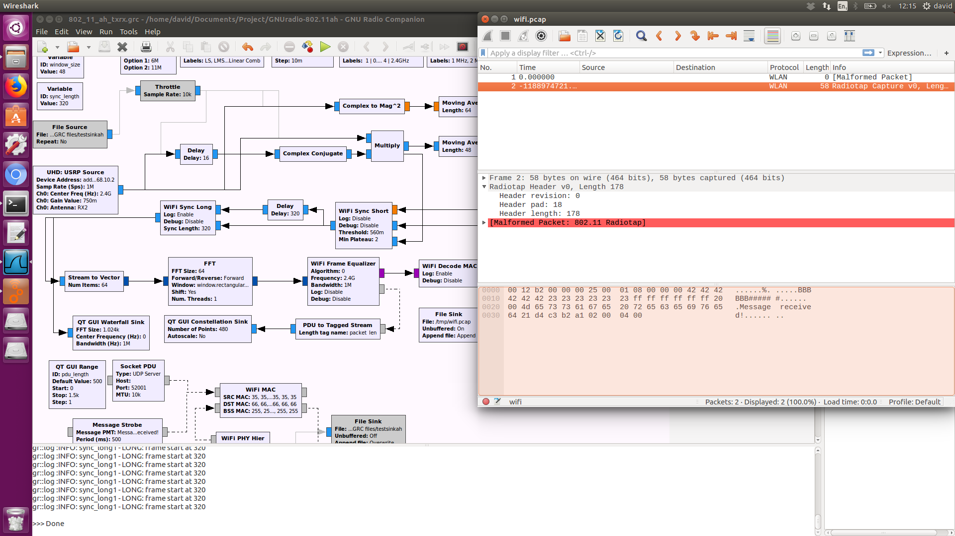
Limitations (1/3)
Very chaotic block scheme, flow connections all over the place.
Malformed packets (Wireshark), or no packets received at all.
USRP buffer overflow
Very spread-out OFDM subcarrier I/Q constellation points.

Slide 8
Limitations (2/3)
Fixes to GNUradio configurations:
USRP TX “LO offset”
Set to 6 MHz in order to be able to receive packets (why?)
Sampling rate had to be at least 2 MHz
Sampling rate == Channel bandwith
Channel bandwith of 1 MHz didn’t work
Why? Will be explained later (S1G PHY layer)

Slide 9
Limitations (3/3)
Added European frequency band
(863 – 868 MHz)
High MCS index -> no reliable reception
QAM64 didn’t work, didn’t even try QAM256
Intermezzo:
A lot was lacking in not only the model, but also the underlaying OOT blocks.
find literature // understand OFDM concepts first before applying anything in GNUradio or C++.

Slide 10
Current work (1/5)
Goals
Implement ‘low hanging fruit’ changes for 802.11ah PHY in model and sub-model blocks.
Study 802.11ah MAC layer.
Reality
Lack of knowledge or new to:
GNUradio, OFDM
Most changes were rooted through many

Slide 11
Current work (1/5)
Goals
Learn about OFDM
Carriers vs symbol
Pilot vs data vs guard carriers (incl DC)
Data to symbol mapping
IFFT on TX side, FFT on RX side
Cyclic prefixing (Guard interval)

